Slide 1
Welcome
Special Guests

Slide 2
First Name
Last Name
Title
Company

Slide 4
First Name
Last Name
Title
Company

Slide 6
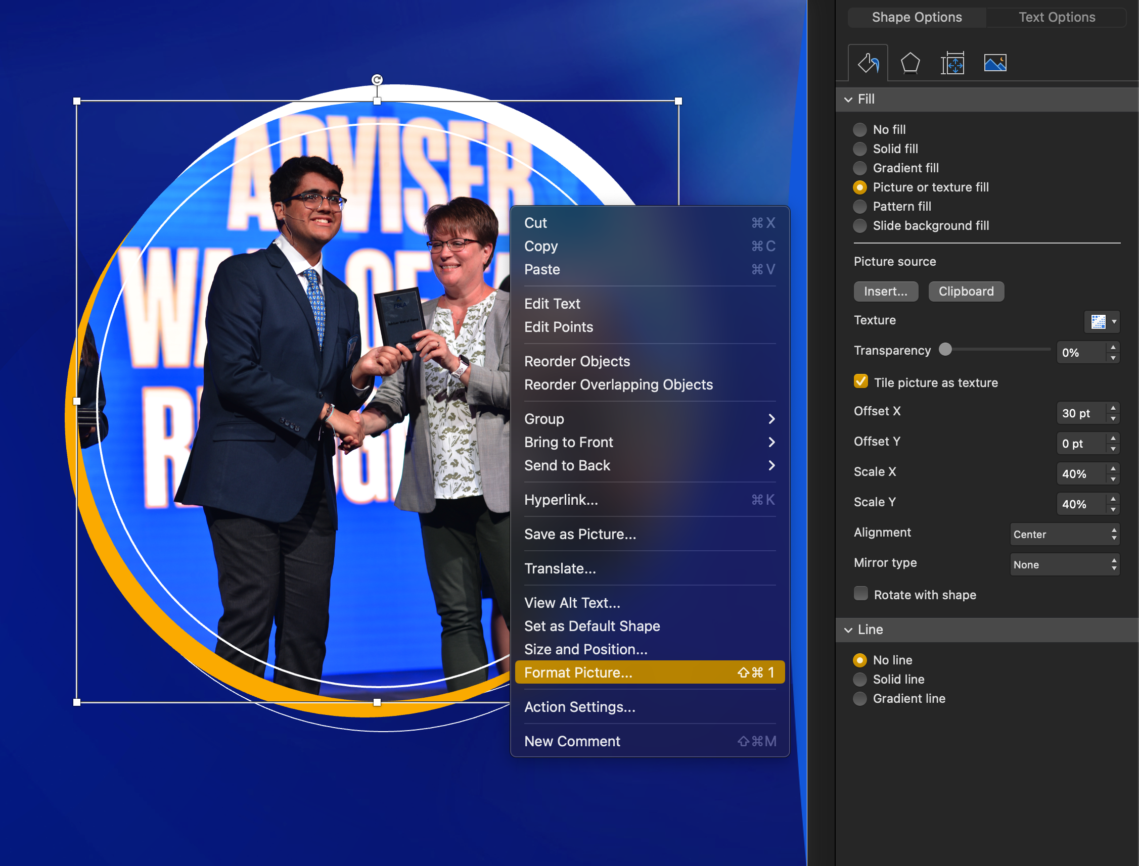
How to replace a rounded photo: -Right click on the photo. -Format Picture. -Click the button “Insert…” -Be sure ”Tiled picture as texture” is selected. -Change Offset and Scale to position the new photo.

Slide 7
Title Text
Slide Text Subhead
Slide Text

Slide 8
Title Text
Slide Text Subhead
Slide Text

Slide 9
Sponsors

