Slide 1
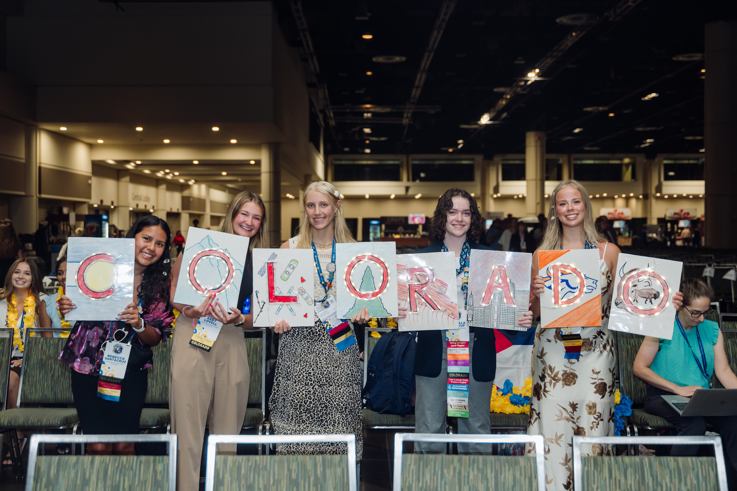
HIGH SCHOOL COMPETITIVE EVENTS
www.coloradofbla.org/competitions

Slide 2





12 Colorado Districts
Geographic regions
DISTRICT LEADERSHIP CONFERENCE (DLC)
Individual, one-day DLCs
February 1st - 6th
www.coloradofbla.org/dlc
DLC Scholarships
Up to 2 per district
Due December 13th

Slide 3
April 21-23
Top 4 competitors per event from your DLC
STATE LEADERSHIP CONFERENCE (SLC)
Other ways to be eligible to attend
www.coloradofbla.org/slc
SLC Scholarships
March 3rd for SLC scholarship
March 21st for college scholarships from CO FBLA

Slide 4
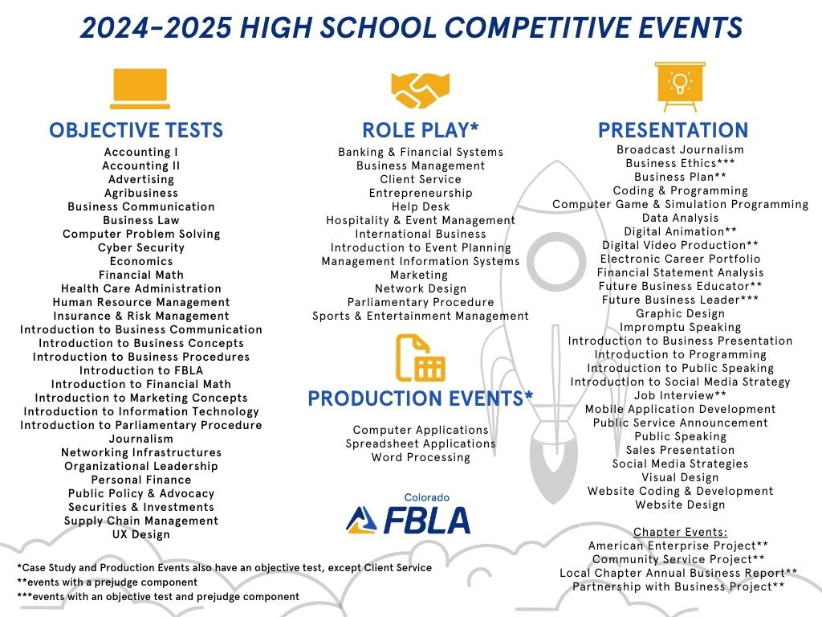
Notes:
There are four types of events - objective tests, role play events, production events, and presentation events. We will go through each type of event so you can identify which one or two events you want to compete in during the District Leadership Conferences.

Slide 5
Notes:
Students can do up to two events at District Conferences.
You can choose to compete in two "non-live" events, which are the objective tests and production events. These competitors do not present in front of a judge.
Chapters can have an unlimited number of competitors in each non-live event, but check with your chapter adviser in case your school has different rules.

Slide 6
Notes:
If you want to present in front of a judge, you can do one "live" event and one testing event at Districts. These are the role play and presentation events.
Chapters are limited on entries based on membership.
We will spend time reviewing each category of event, and hearing some tips from your State Officer team about how to be successful.

Slide 7
Membership Limits for “Live” Events -
based on membership as of December 3, 2024
Under 49 members = 3 entries per chapter
50 - 100 members = 4 entries per chapter
101 - 150 members = 5 entries per chapter
151+ members = 6 entries per chapter
Notes:
If you want to present in front of a judge, you can do one "live" event and one testing event at Districts. These are the role play and presentation events.
Chapters are limited on entries based on membership.
We will spend time reviewing each category of event, and hearing some tips from your State Officer team about how to be successful.

Slide 8
OBJECTIVE TESTS
  Individual events
  Online test
  100 multiple choice questions
  50-minutes
  DLC: take at school prior to DLC
  SLC: take on site at scheduled time
Note: Business Calculations now called Financial Math
Notes:
Annabelle talk about her success in Intro to FBLA OR Isabella talk about Organizational Leadership

Slide 9
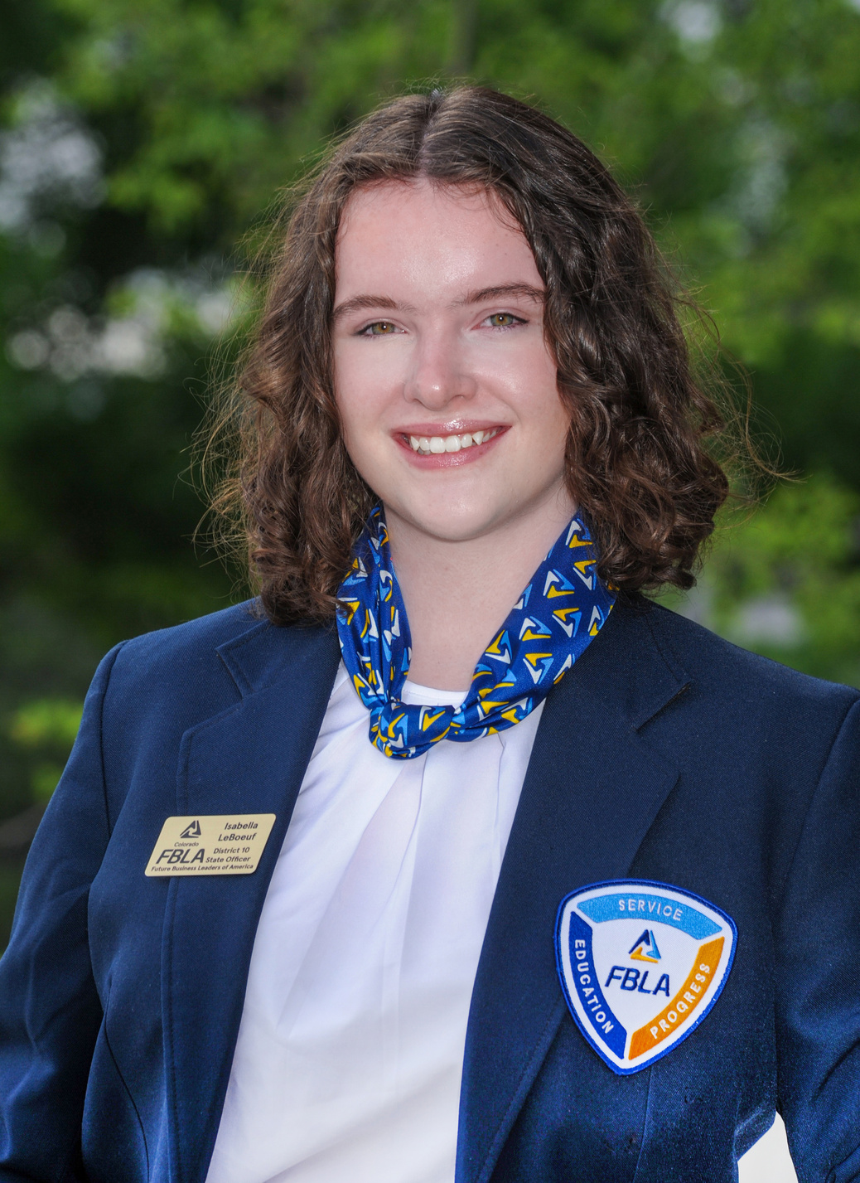
OBJECTIVE TESTS
  Individual events
  Online test
  100 multiple choice questions
  50-minutes
  DLC: take at school prior to DLC
  SLC: take on site at scheduled time
Note: Business Calculations now called Financial Math
Notes:
Annabelle talk about her success in Intro to FBLA OR Isabella talk about Organizational Leadership

Slide 10
PRODUCTION EVENTS
  Individual events
  Two online tests
  100 multiple choice question test
    50-minutes
  Production test to demonstrate skill
    1-hour for Spreadsheet & Word
    2-hours for Computer Apps
  DLC: take both tests at school prior to and submit production as prejudge
  SLC: production test done prior and submitted as prejudge but objective test done on site at scheduled time
Note: Database Design was retired

Slide 11
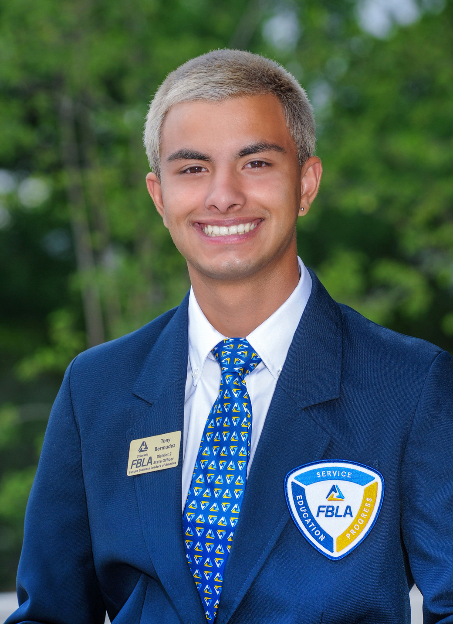
PRODUCTION EVENTS
  Individual events
  Two online tests
  100 multiple choice question test
    50-minutes
  Production test to demonstrate skill
    1-hour for Spreadsheet & Word
    2-hours for Computer Apps
  DLC: take both tests at school prior to and submit production as prejudge
  SLC: production test done prior and submitted as prejudge but objective test done on site at scheduled time
Note: Database Design was retired

Slide 12
ROLE PLAY EVENTS
Two Parts: Objective Test & Role Play
Teams of 1-3 competitors
(Client Service & Parli Pro are unique)
Objective Test
  100 multiple choice questions
  50-minutes
  DLC: take at school prior to DLC
  SLC: take on site at scheduled time
  Each team member takes individually and scores are averaged
Role Play
  20-minutes with case study
  7 minutes to present to judges
  Judges can interact throughout
Notes:
Yaelyn and/or Annabelle talk about Intro to Event Planning

Slide 13
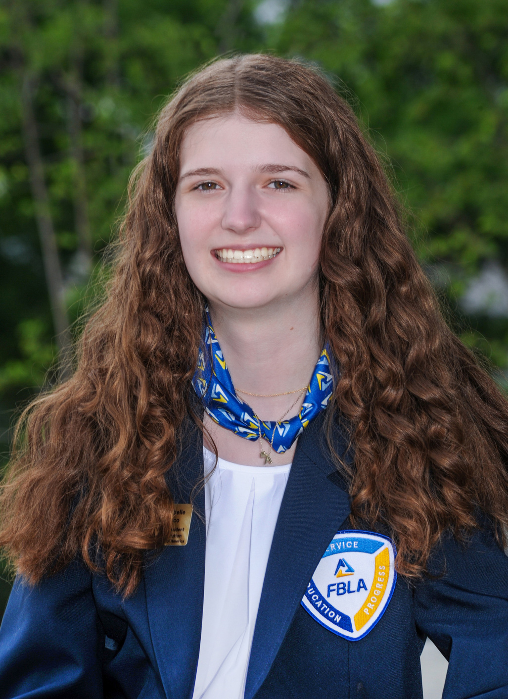
ROLE PLAY EVENTS
Two Parts: Objective Test & Role Play
Teams of 1-3 competitors
(Client Service & Parli Pro are unique)
Objective Test
  100 multiple choice questions
  50-minutes
  DLC: take at school prior to DLC
  SLC: take on site at scheduled time
  Each team member takes individually and scores are averaged
Role Play
  20-minutes with case study
  7 minutes to present to judges
  Judges can interact throughout
Notes:
Yaelyn and/or Annabelle talk about Intro to Event Planning

Slide 14
PRESENTATION EVENTS
  Mix of team and individual events
  Some events have an objective test
  Some events have prejudged items
  Most events have a topic and instructions for competitors to prepare presentations
  SLC: set-up time is 1-minute and Internet access for limited events
  Q&A from judges
Notes:
Lyndi talk about success in Broadcast Journalism

Slide 15
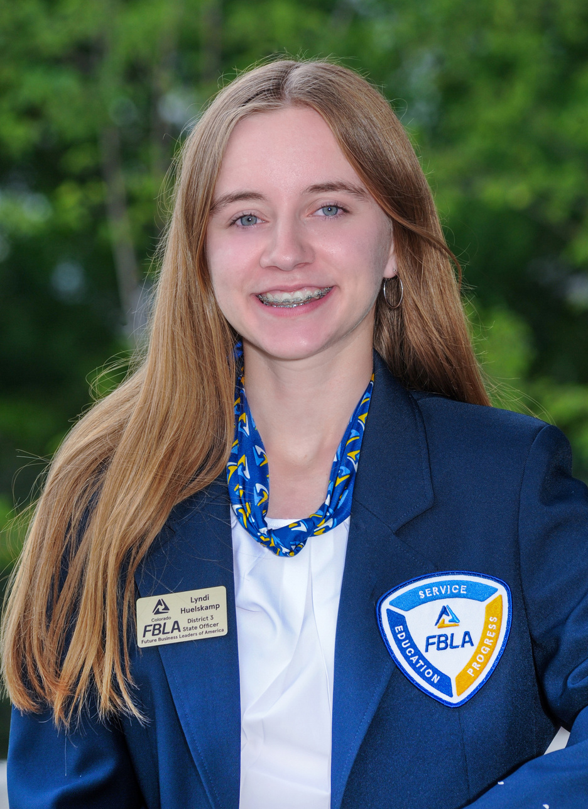
PRESENTATION EVENTS
  Mix of team and individual events
  Some events have an objective test
  Some events have prejudged items
  Most events have a topic and instructions for competitors to prepare presentations
  SLC: set-up time is 1-minute and Internet access for limited events
  Q&A from judges
Notes:
Lyndi talk about success in Broadcast Journalism

Slide 16
CHAPTER EVENTS
  Team events, 1-3 competitors
  One per chapter
  Topic and instructions provided in event guidelines
  Prejudged report for all chapter events
  Only offered at SLC
  Competitors can compete in this and one other event, if you qualify at DLC
Notes:
Caleb talk about his success in American Enterprise Project

Slide 17
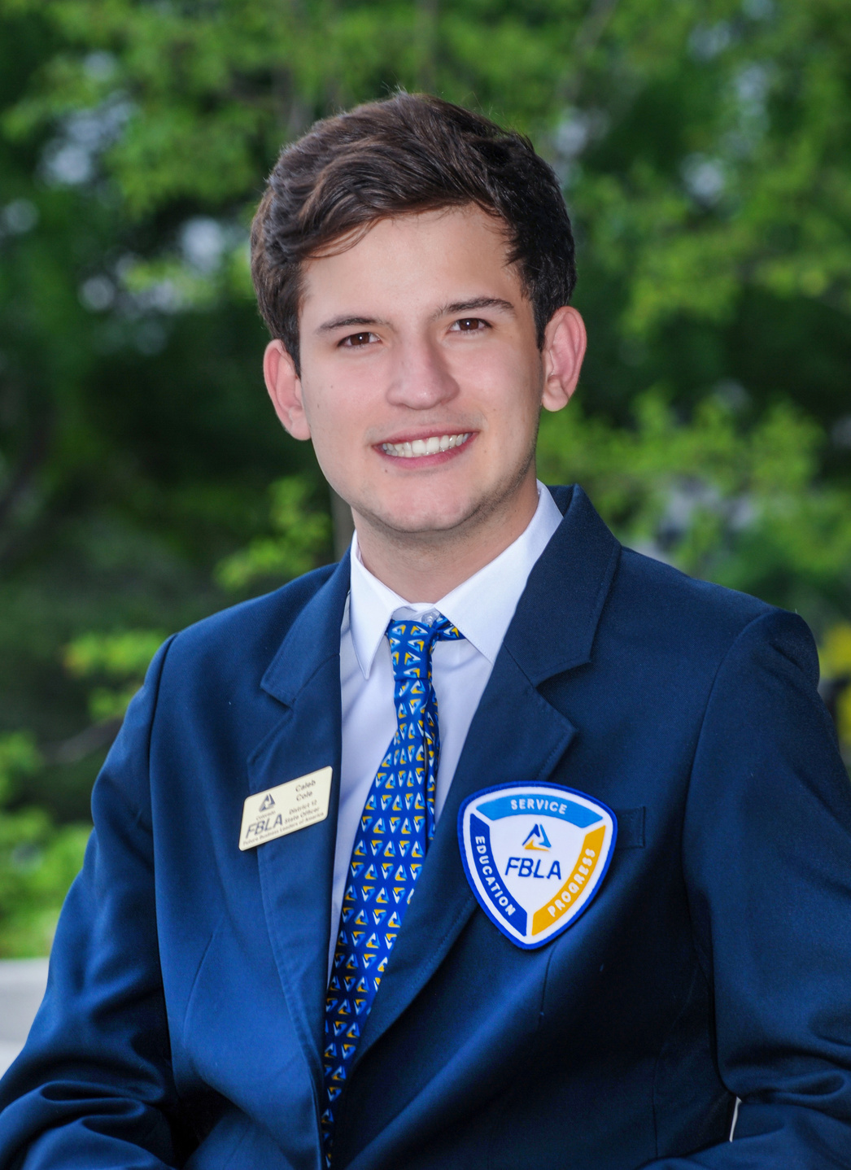
CHAPTER EVENTS
  Team events, 1-3 competitors
  One per chapter
  Topic and instructions provided in event guidelines
  Prejudged report for all chapter events
  Only offered at SLC
  Competitors can compete in this and one other event, if you qualify at DLC
Notes:
Caleb talk about his success in American Enterprise Project

Slide 18

Read your event guidelines carefully and check DLC and SLC deadlines
www.coloradofbla.org/competitions
Notes:
Colorado guidelines have more state-specific information than the guidelines posted on the National website.

Slide 19

DLC Deadlines
December 2nd: Membership Registration in FBLA Connect
December 13th: DLC Registration
December 20th: Last Day for Changes to Registration
Check your District & talk to your adviser for Testing Windows and Prejudge Deadlines

Slide 20
SLC Deadlines
March 14th: Selection Committee Application
March 17th: Peak Awards Submission
March 21st: Early Bird Registration, State Officer Application, “Of the Year” Award Submissions
March 31st: Final Registration Deadline
April 11th: BAA Deadline for Recognition
April 16th: Prejudge and Production Submissions

Slide 21


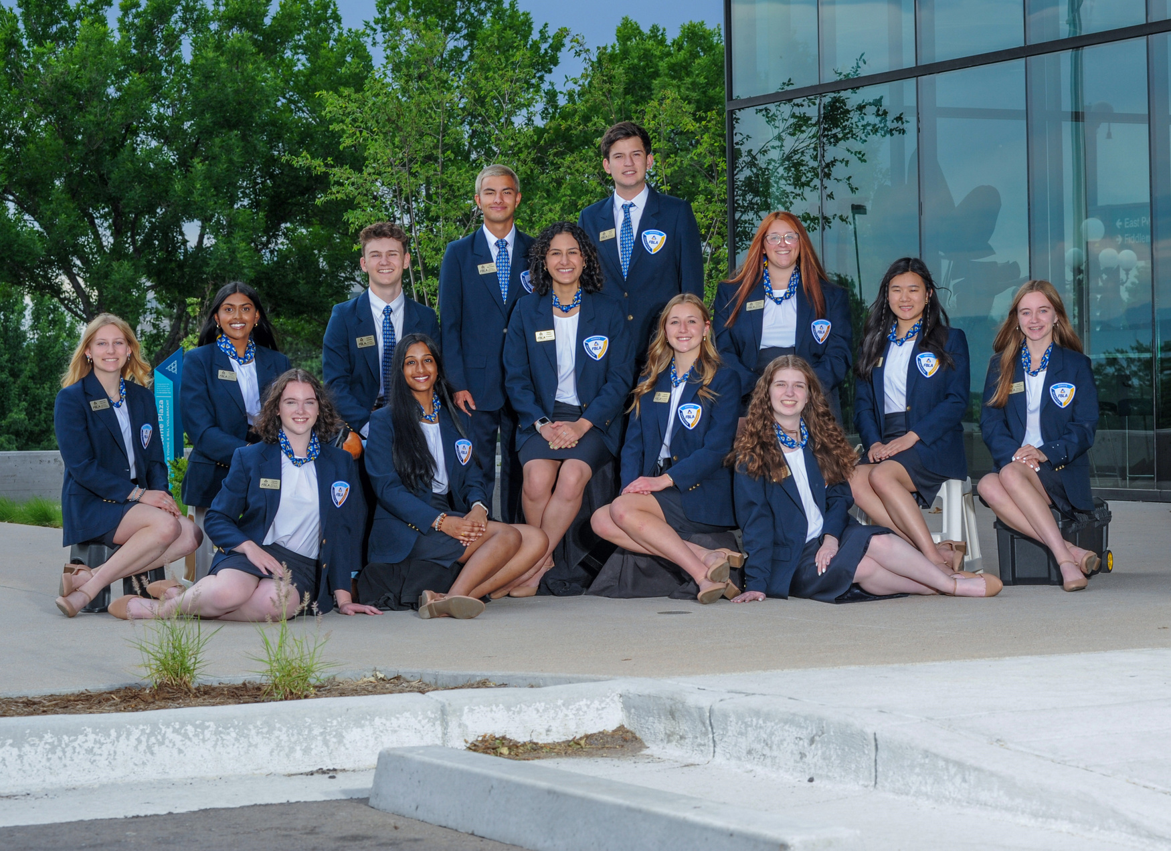
STATE OFFICERS
Notes:
State Officers can come to your chapter for a virtual or in-person visit to talk more about the competitive events and how to prepare.

